Slide 1
S1 resolution and SER problems: part1
Сampaign V
Oleynikov Vladislav
28 Nov 2018

Slide 2
Algorithm:
11713f949ea5bffcc2f0ceb22d1267b5f314a5af
Merge branch 'barycenter' into 'master'

Slide 3
Cut list:
bool cls0_is_S1 = clusters.at(0)->f90 > 0.2;
bool cls0_is_full = clusters.at(0)->rep == 1;
bool cls0 = nc_i == 0;//cluster 0
bool cls1 = nc_i == 1;//cluster 1
bool is_S1 = nc == 2 && cls0 && cls0_is_full && cls0_is_S1;
bool is_S2 = nc == 2 && cls1 && cls0_is_full && cls0_is_S1;
bool is_S1_only = nc == 1 && cls0_is_full && cls0_is_S1;
bool is_S2_v2 = is_S2 && clusters.at(1)->f90 < 0.2;
bool region_of_S2_uniformity =
(clusters.at(1)->pos_x > 2.2) && (clusters.at(1)->pos_x < 2.8) &&
(clusters.at(1)->pos_y > 2) && (clusters.at(1)->pos_y < 3);
bool is_good_r537_v1 = is_S1_S2 && region_of_S2_uniformity && clusters.at(0)->charge > 300 && clusters.at(0)->charge < 700;

Slide 4
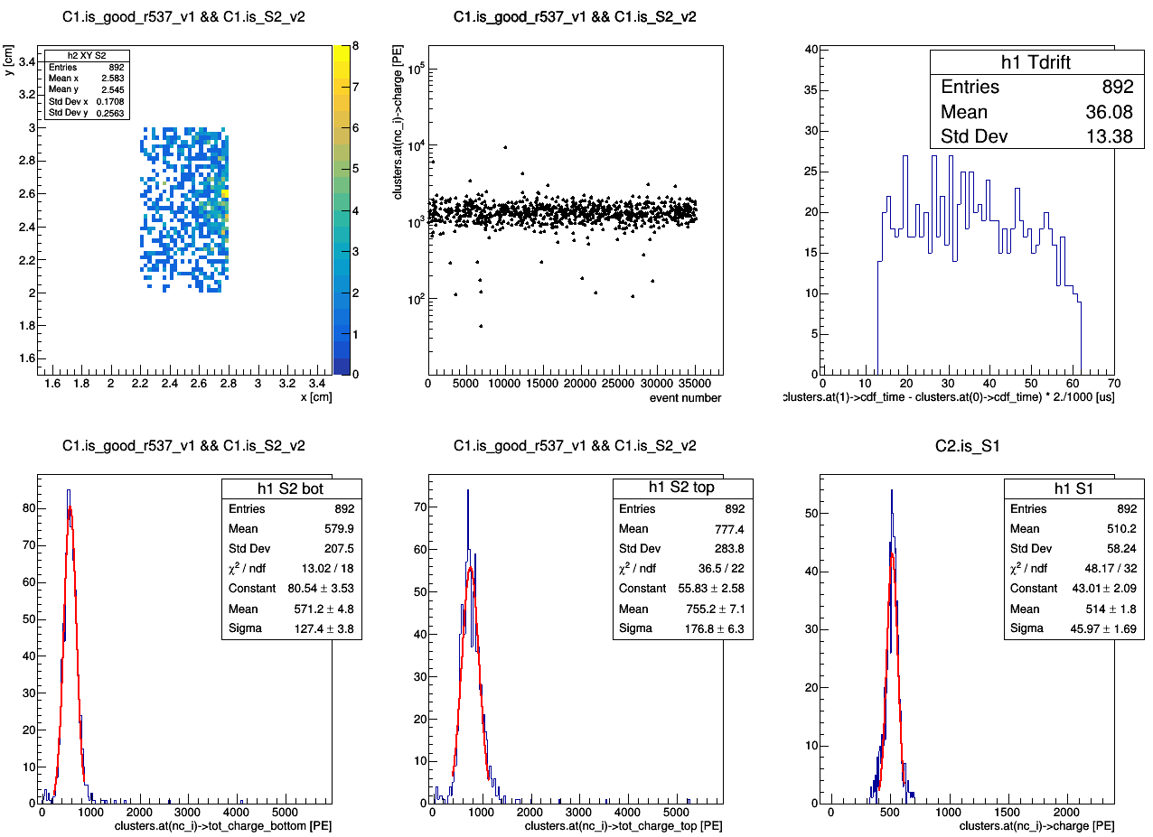
Ph2, Am241, run 537

Slide 5
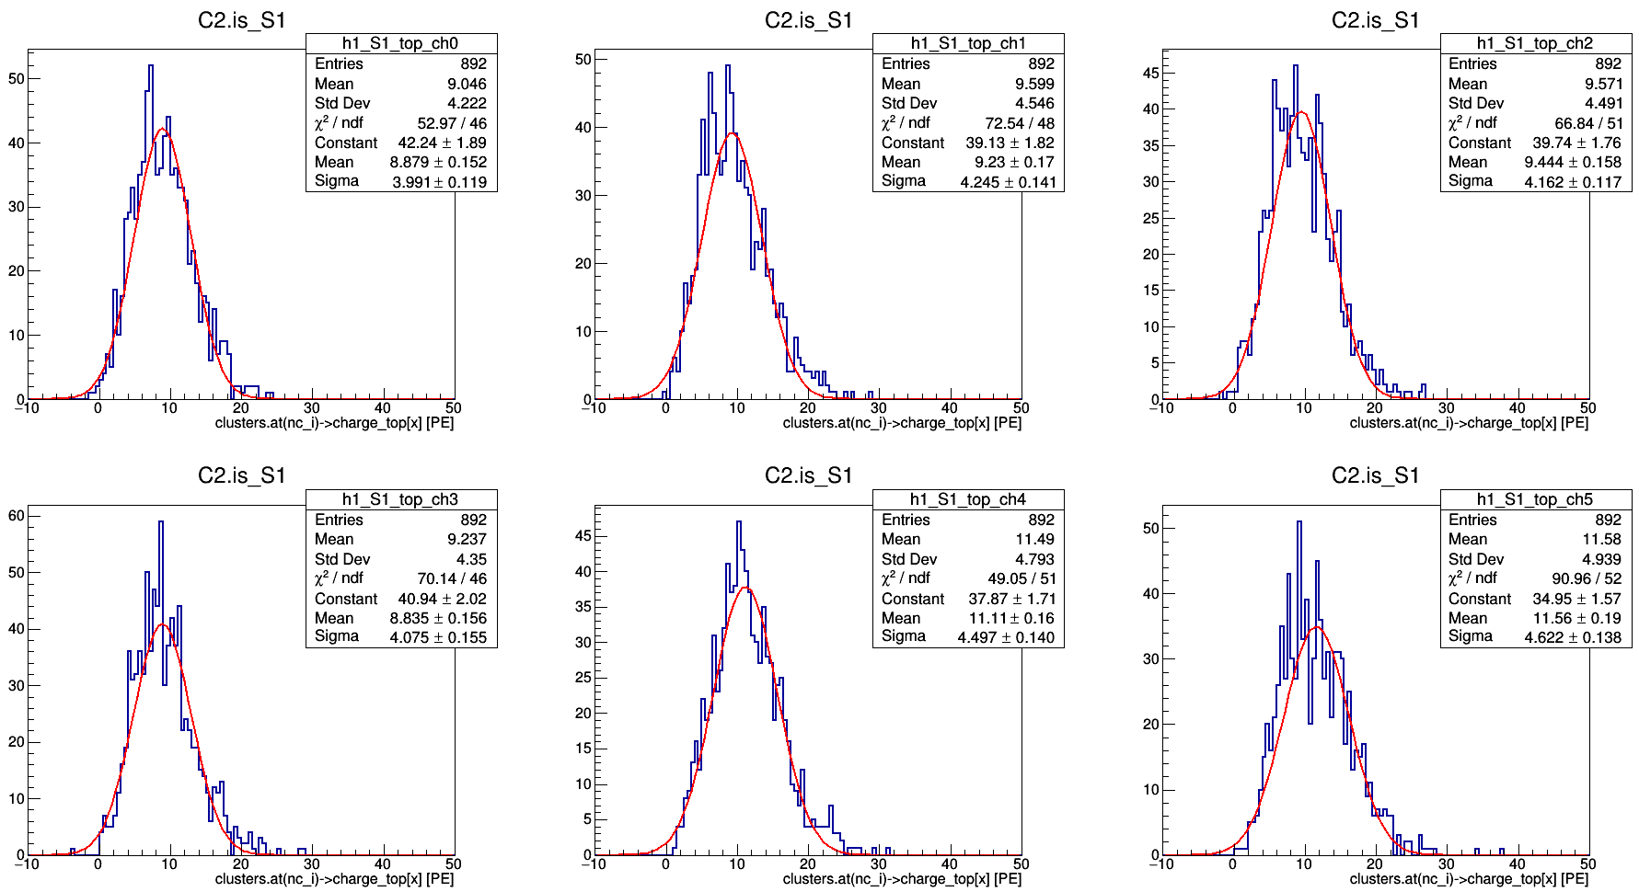
Ph2, Am241, run 537

Slide 6
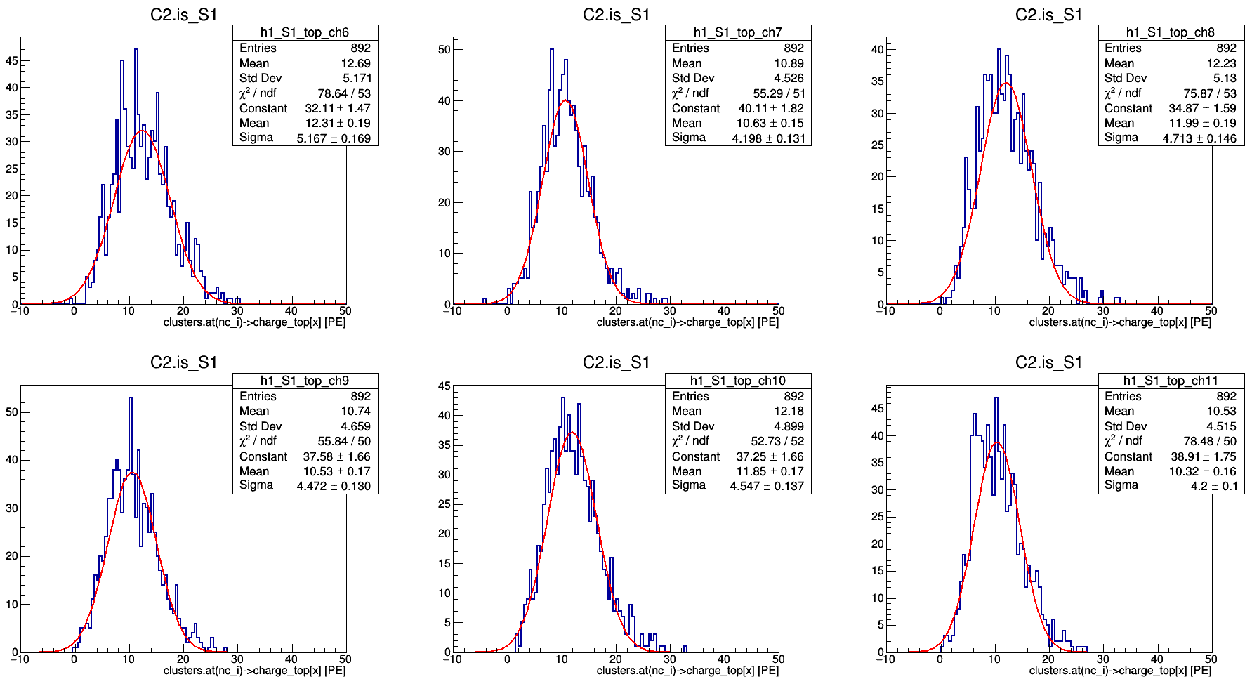
Ph2, Am241, run 537

Slide 7
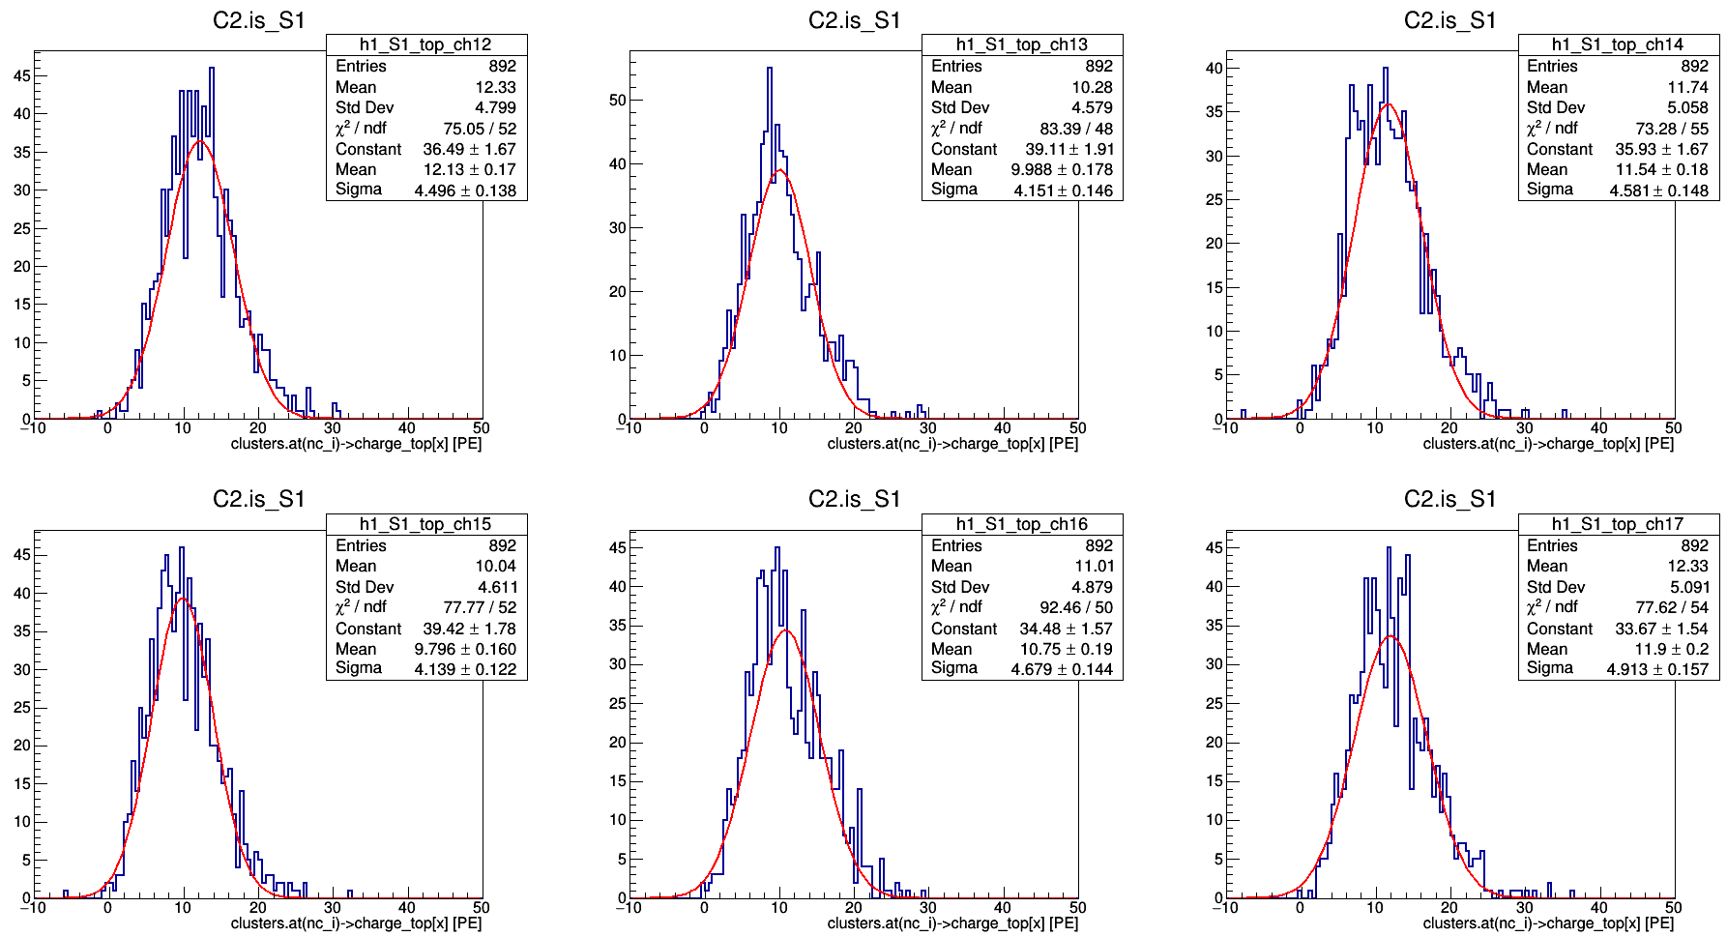
Ph2, Am241, run 537

Slide 8
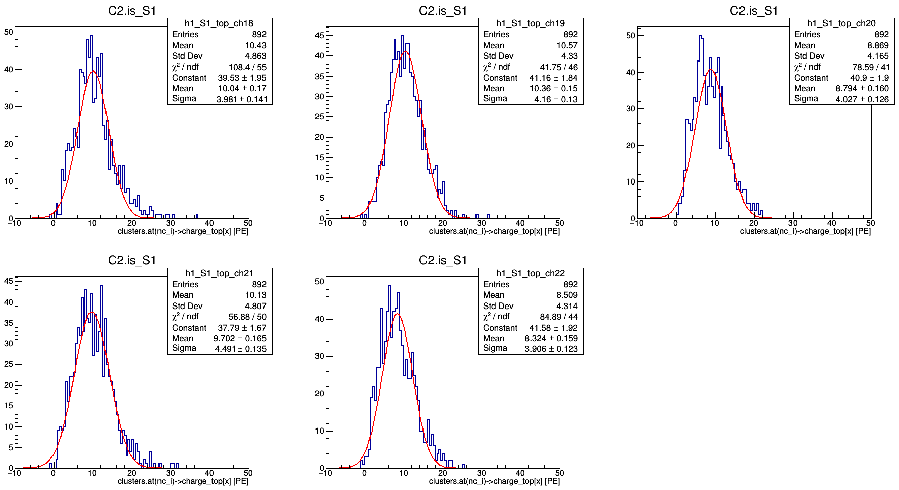
Ph2, Am241, run 537

Slide 9
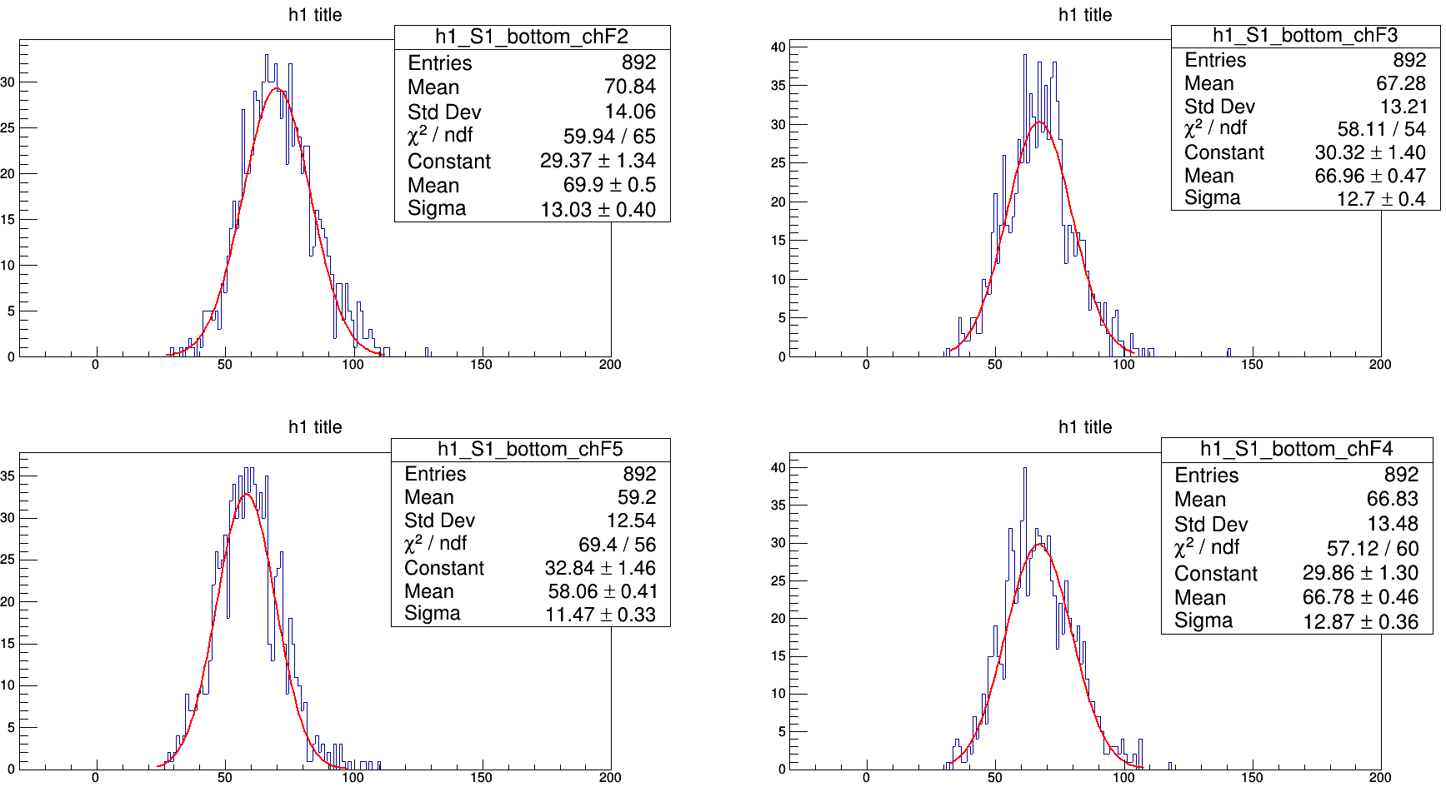

Slide 10
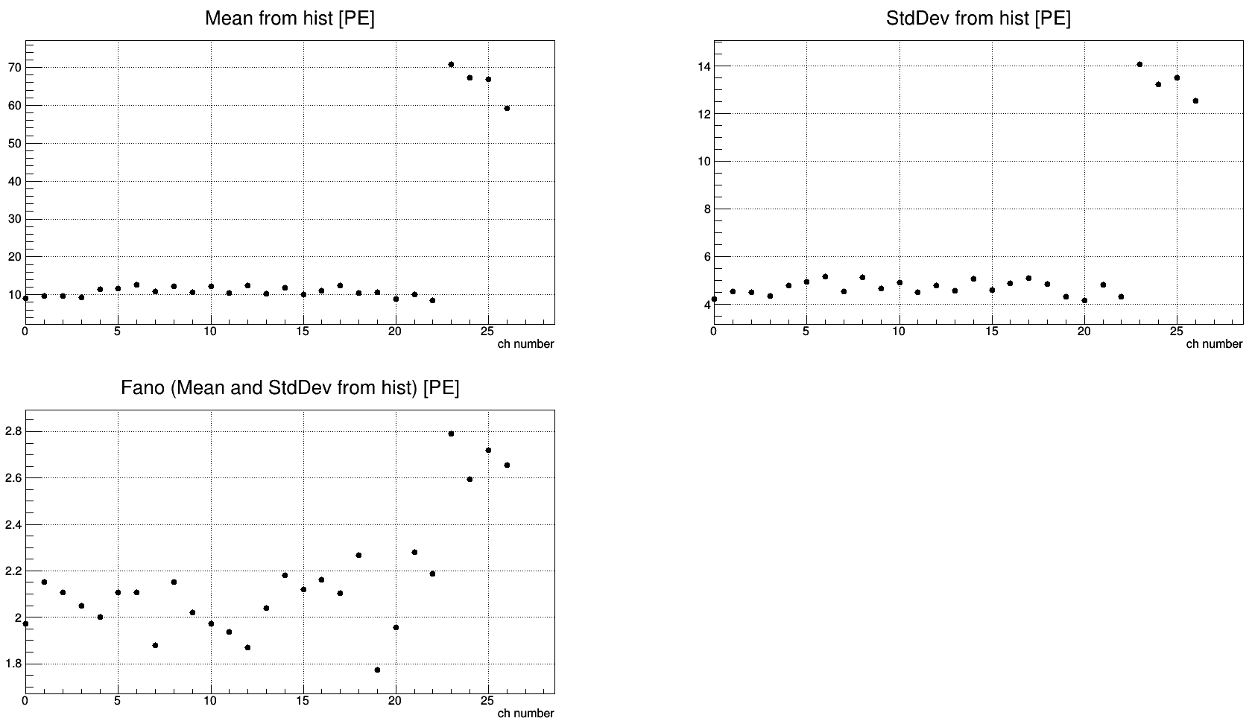
Ph2, Am241, run 537
Ch 0 – 22: top SiPMs
Ch 23 – 26: bottom SiPMs

Slide 11
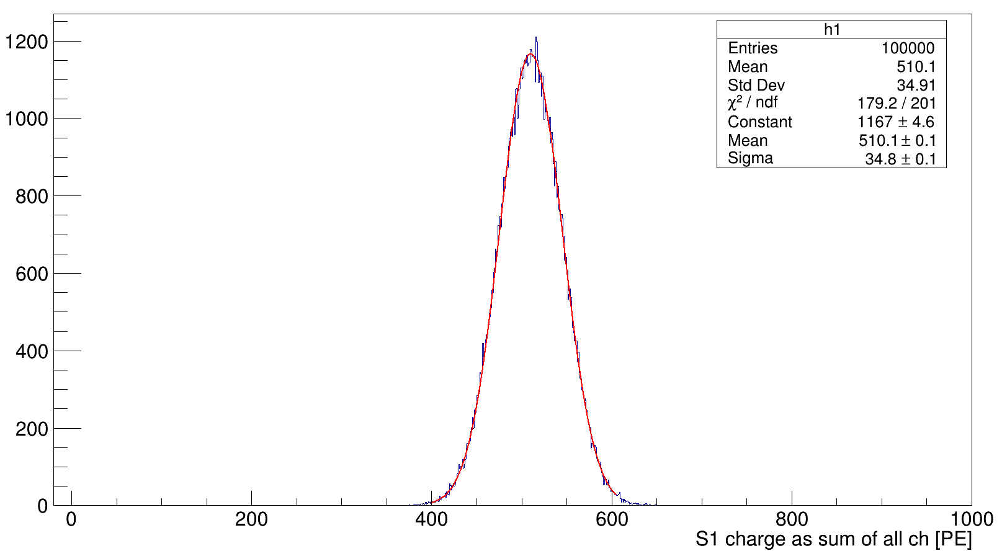
ToyMC using data from Ph2, Am241, run 537

